Slide 1
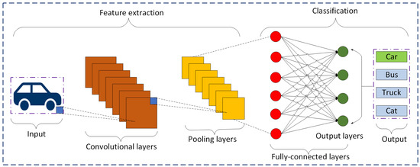
Evolution of CNNs: From VGG to Inception
As networks grew deeper, researchers developed "backbones" to act as efficient feature extractors.
VGG: Popularized the use of small 3 x 3 filters stacked deeply to increase the receptive field.
Inception: Introduced multi-scale processing by using parallel filters of different sizes within the same layer.

Slide 2
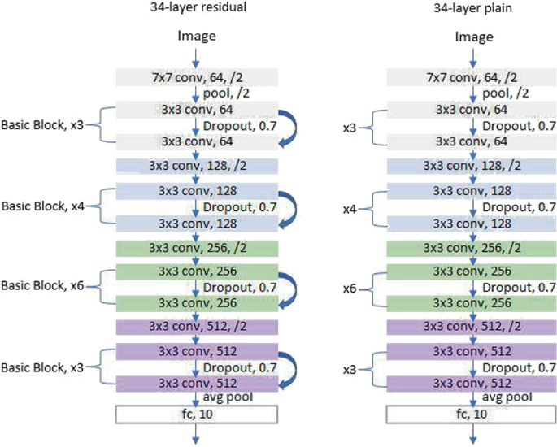
ResNet: Solving the Vanishing Gradient Problem
Extremely deep networks often suffer from signal loss, where gradients become too small to update weights.
Skip Connections: ResNet passes the input of a layer directly to the output of a later layer (Identity Mapping).
This allows the model to learn "residuals" and makes it possible to train networks with hundreds or thousands of layers.

Slide 3
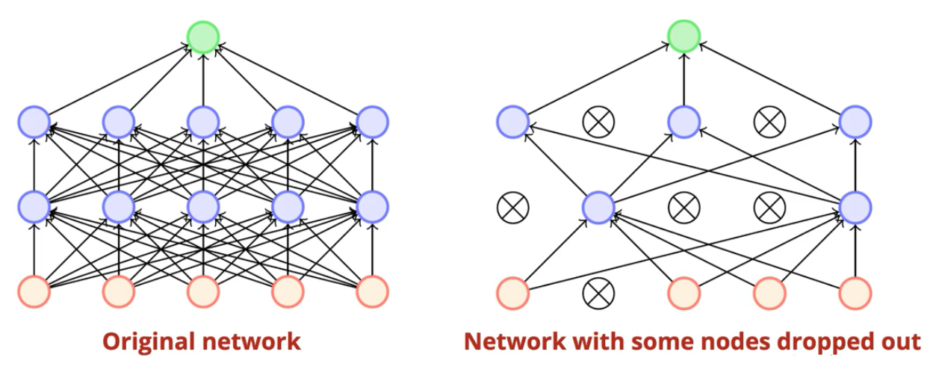
Batch Normalization & Dropout
Batch Normalization: Re-scales the outputs of a layer to have a mean of 0 and a variance of 1. This stabilizes training and allows for higher learning rates.
Dropout: Randomly "turns off" a percentage of neurons during training (e.g., 50%). This prevents the model from relying too heavily on specific neurons, reducing overfitting.

